Slide 1
Scientific lens on 2GEN approaches for supporting families
Maine 2GEN Summit: Explore, Inspire, Innovate
Sarah Watamura, Ph.D. Oct, 2023

Slide 2
Roadmap
Science in its place
Poverty by the numbers
Poverty as context
Children and families at the heart
Early brain development
Brain changes and parenting
Caregivers as people
Poverty, mental health, substance use & brain changes

Slide 3
Two-Eyed Seeing
“We often explain Etuaptmumk - Two-Eyed Seeing by saying it refers to learning to see from one eye with the strengths of Indigenous knowledges and ways of knowing, and from the other eye with the strengths of Western knowledges and ways of knowing ... and learning to use both these eyes together, for the benefit of all.”
http://www.integrativescience.ca/Principles/TwoEyedSeeing/

Slide 4
Roadmap
Science in its place
Poverty by the numbers
Poverty as context
Children and families at the heart
Early brain development
Brain changes and parenting
Caregivers as people
Poverty, mental health, substance use & brain changes

Slide 5
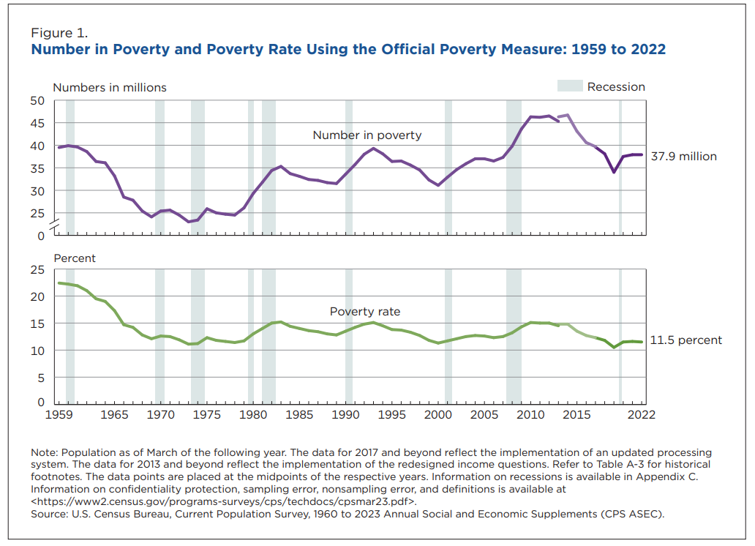

Slide 6
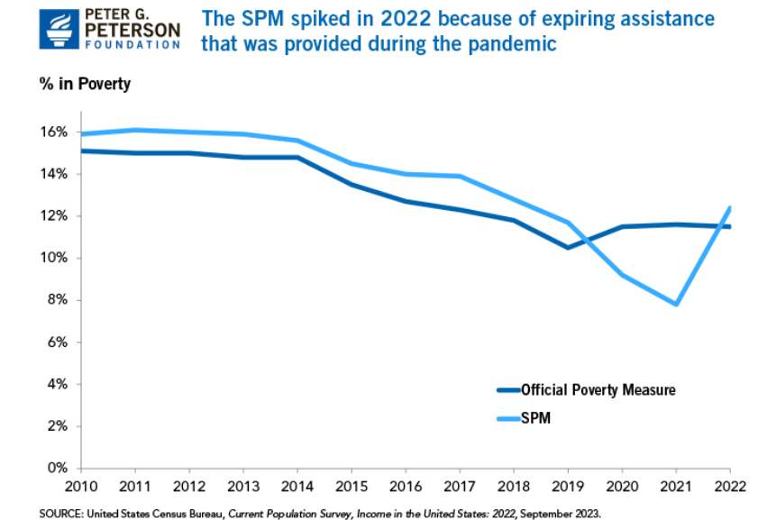

Slide 7
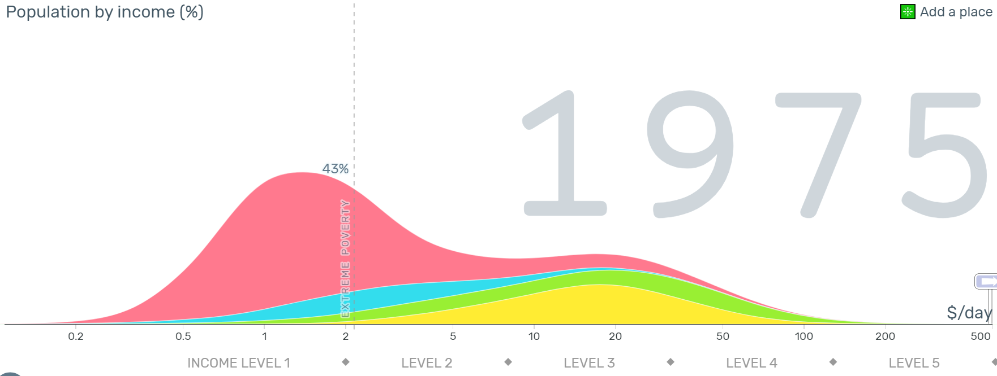
https://www.gapminder.org/tools/#$model$markers$billy$encoding$selected$data$;;;;;;&chart-type=mountain&url=v1

Slide 8
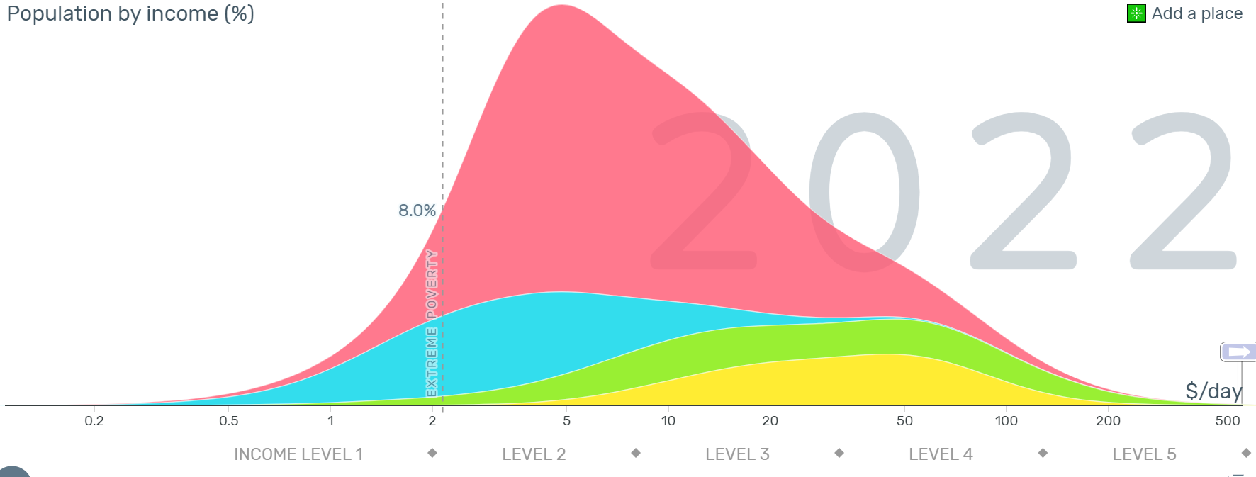
Expected to INCREASE to 9% for 2023
https://www.gapminder.org/tools/#$model$markers$billy$encoding$selected$data$;;;;;;&chart-type=mountain&url=v1

Slide 9
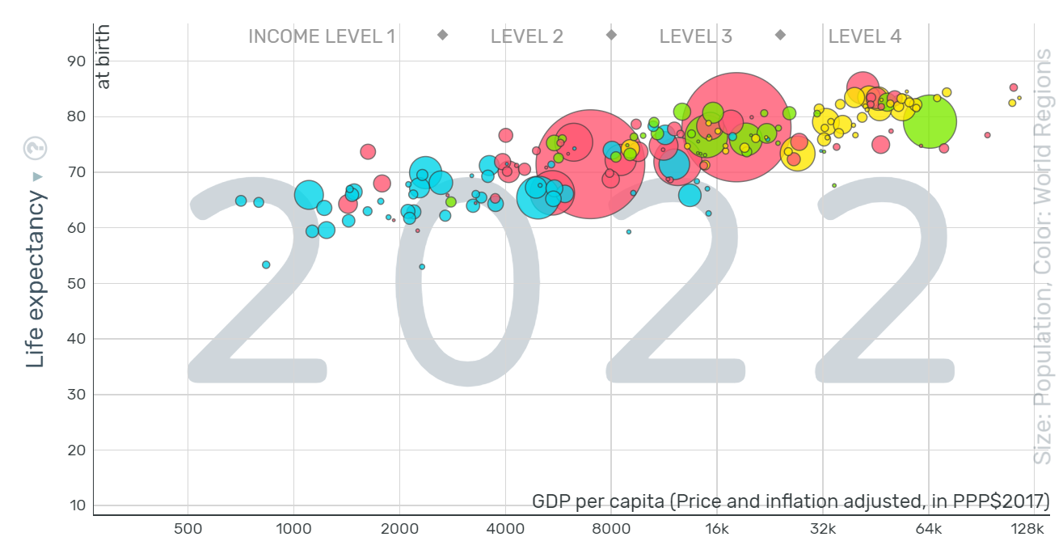
https://www.gapminder.org/fw/world-health-chart/

Slide 10
Roadmap
Science in its place
Poverty by the numbers
Poverty as context
Children and families at the heart
Early brain development
Brain changes and parenting
Caregivers as people
Poverty, mental health, substance use & brain changes
Cash transfer effectiveness
Cash transfer & brain development

Slide 11
Dimensions of Stress
Unpredictability/
Uncontrollability

Slide 12
Dimensions of Stress
Unpredictability/
Uncontrollability
Deprivation

Slide 13
Dimensions of Stress
Unpredictability/
Uncontrollability
Deprivation
Adversity/threat

Slide 14
Dimensions of Poverty
Systemic Perpetuation/Maintenance of Power & Privilege/Intersectionality
Unpredictability/
Uncontrollability
Deprivation
Adversity/threat

Slide 15
Dimensions of Poverty
Systemic Perpetuation/Maintenance of Power & Privilege/Intersectionality
Stereotyping/Single Story
Unpredictability/
Uncontrollability
Deprivation
Adversity/threat

Slide 16
Dimensions of Poverty
Systemic Perpetuation/Maintenance of Power & Privilege/Intersectionality
Stereotyping/Single Story
Unpredictability/
Uncontrollability
Deprivation
Adversity/threat
Discrimination/Harassment

Slide 17
Dimensions of Poverty
Systemic Perpetuation/Maintenance of Power & Privilege/Intersectionality
Stereotyping/Single Story
Unpredictability/
Uncontrollability
Deprivation
Adversity/threat
Patronizing/Paternalism/White Savior/De-centering/Shaming
Discrimination/Harassment

Slide 18
Roadmap
Science in its place
Poverty by the numbers
Poverty as context
Children and families at the heart
Early brain development
Brain changes and parenting
Caregivers as people
Poverty, mental health, substance use & brain changes
Cash transfer effectiveness
Cash transfer & brain development

Slide 19
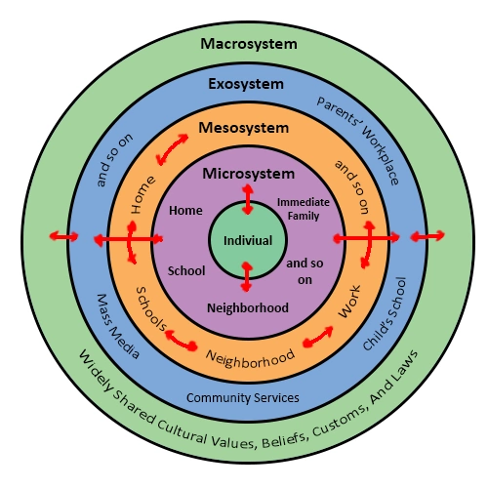
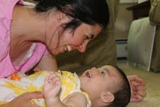

Slide 20
Roadmap
Science in its place
Poverty by the numbers
Poverty as context
Children at the heart
Early brain development
Brain changes and parenting
Caregivers as people
Poverty, mental health, substance use & brain changes
Cash transfer effectiveness
Cash transfer & brain development

Slide 21
What is a sensitive period?
A time in life when an organism is especially open to experience
-the presence of positives
- the presence of negative
- the absence of expected positives

Slide 22
The fourth trimester

Slide 23
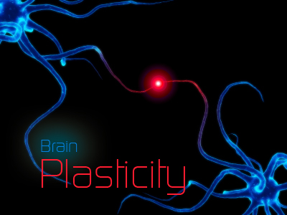
Benefits of Underdevelopment?

Slide 24
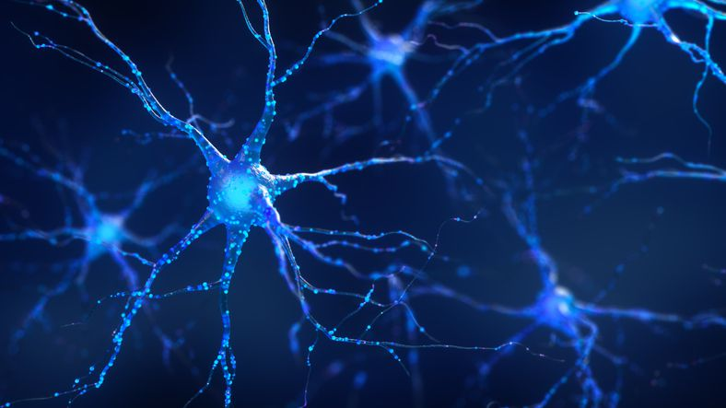
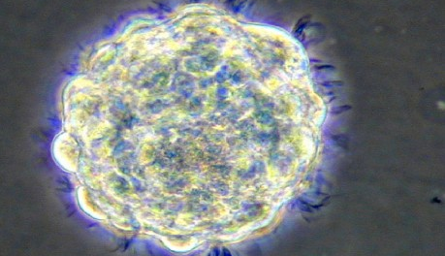
The fetal and infant brain is under active construction
By seven weeks nerve cells in brain have begun forming primitive nerve paths
Over 100,000 nerve cells/minute
At birth the baby will have 100 billion nerve cells
Proliferation, migration, differentiation, synaptogenesis, myelination continue

Slide 25
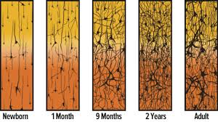
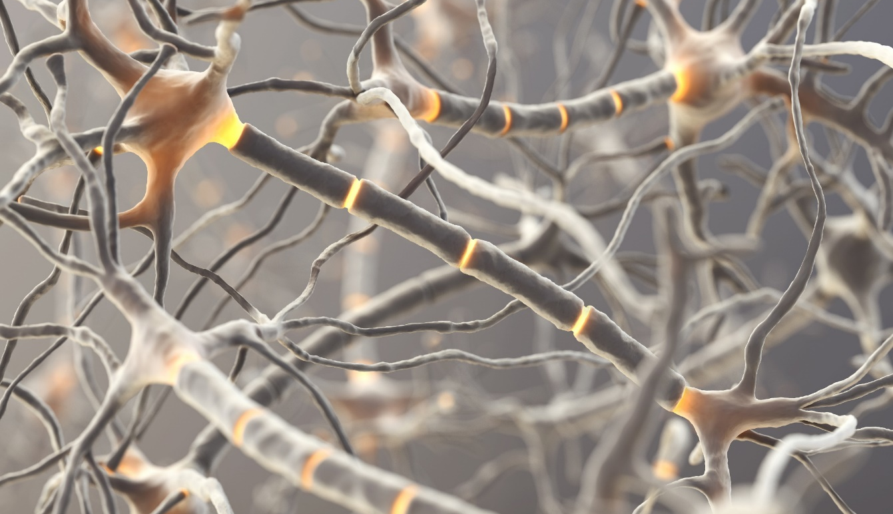
Synapses & Neurons
Shore, 1997
Notes:
The other important thing that happens is neurons begin communicating with each other. They do that through synaptic connections. By about the end of the first year of life, babies also have the most number of synaptic connections. This might sound like a good thing, to have everything wired to everything else, but…

Slide 26
Synaptic Pruning – Easy Reminders
Notes:
….having extra connections in the brain is not efficient.
So, imagine you could link up your phone with everyone else in this building right now. It might seem great to have so many contacts, but then you go outside to make a phone call and you can’t find the one Teresa in all the Teresa’s now in your phone that is really your friend.
So, let’s assume you can’t delete any of the contacts. What would you do to find *your* Teresa faster next time? Probably you would use the “favorites” or “recents” features.
That’s exactly what the baby is busy doing. Keeping synaptic connections for the things that are most important to them (favorites) and between the things that communicate most often (recents). So we want to be sure that the favorites and recents they experience are the ones we really want them to be able to access quickly and frequently.

Slide 27
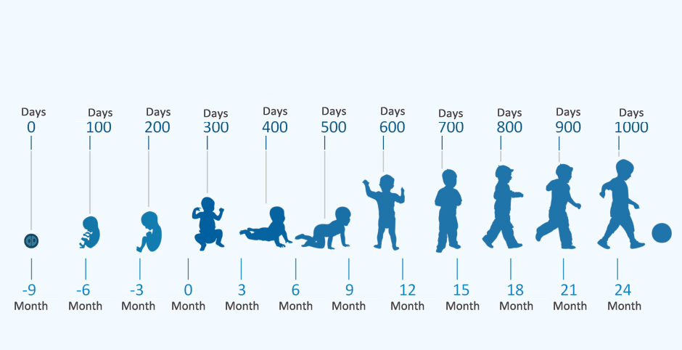
Early Life – the first sensitive period

Slide 28
Roadmap
Science in its place
Poverty by the numbers
Poverty as context
Children at the heart
Poverty and brain development
Brain changes and parenting
Caregivers as people
Poverty, mental health, substance use & brain changes
Cash transfer effectiveness
Cash transfer & brain development

Slide 29
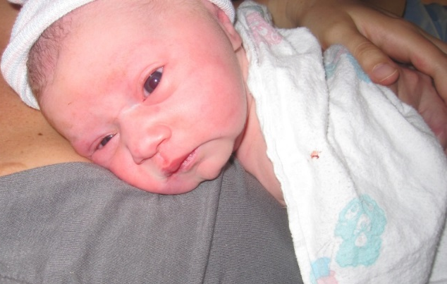
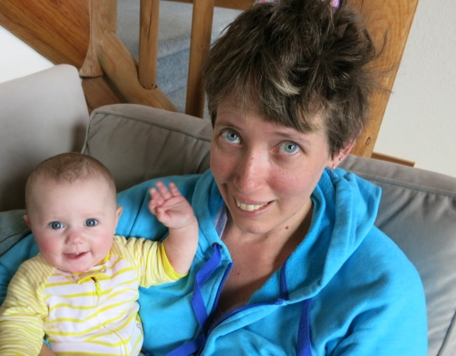
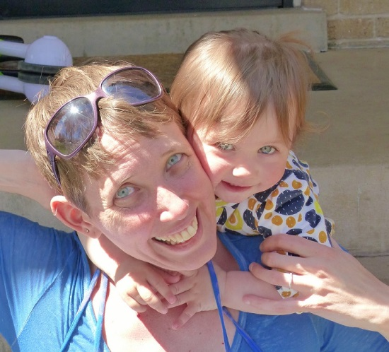
Two Open Windows: The Framework
The agent of change
The social, emotional & educational environment
First & Most Important Sensitive Period
A changing agent

Slide 30
Neural Changes in Support of Parenting
Work from animal models and human mothers and fathers reveals major structural changes and important functional changes to the brain during the transition to parenting that:
Change the way stress is handled
Promote positive emotions and bonding
Increase parental motivation
Promote caregiving behaviors
Pilyoung Kim, Ph.D.

Slide 31
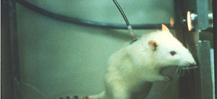
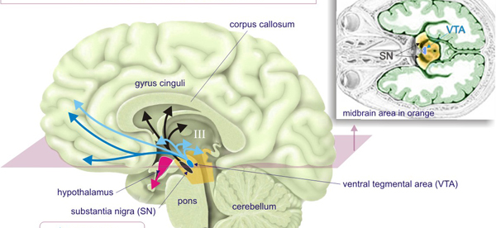
The Reward Circuit

Slide 32
Changes in the Reward Circuit
New mothers and fathers during the first few months postpartum exhibit structural growth of the reward circuit
The amount of the growth is associated with positive feelings mothers reported about their baby (e.g. beautiful, perfect)
More functional brain activity in this region also occurs when looking at pictures of one’s own vs. other infants

Slide 33
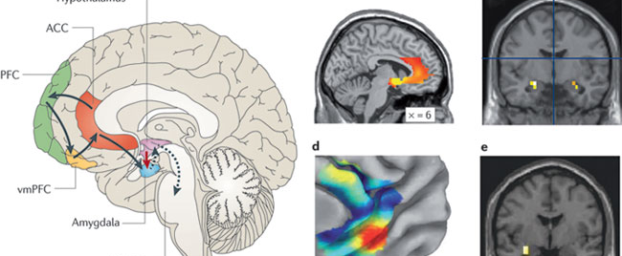
The Social Information Circuit

Slide 34
Changes in the Social Information Circuit
New mothers and fathers exhibit neural plasticity in the circuit including structural increases Kim, Leckman, Mayes, Feldman, et al., 2010; Kim et al., 2014
New parents also exhibit heightened responses in this circuit to infant cries and images of their infant Swain et al., in press

Slide 35
Empathy

Slide 36
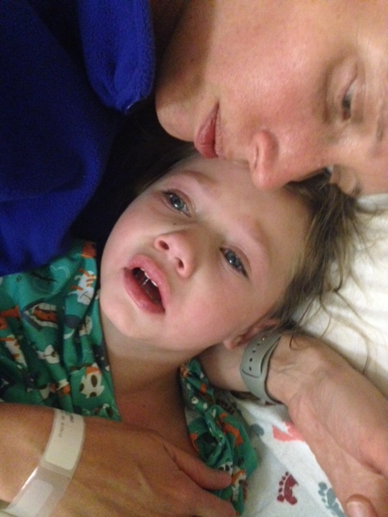
Empathy

Slide 37
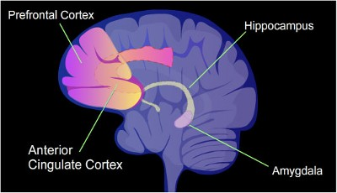
Emotion Regulation Circuits

Slide 38
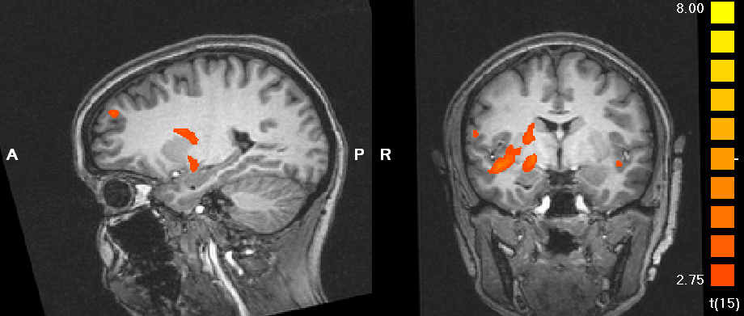
Neural Activation Differences & Parenting
Response to own infant vs. another infant & rated maternal sensitivity
Kim, et al. 2011. Journal of Child Psychology and Psychiatry

Slide 39
Roadmap
Science in its place
Poverty by the numbers
Poverty as context
Children and families at the heart
Early brain development
Brain changes and parenting
Caregivers as people
Poverty, mental health, substance use & brain changes

Slide 40
Caregivers are people
Yes, they are the powerful, impactful change agents for their children
And, yes, they are people with histories, needs, dreams, stress, and often current and historical trauma
2GEN strategies are for caregivers as people, and as caregivers

Slide 41
Promoting Caregiver Resilience
Science-based information
Support, connection and community
Behavioral strategies
Cognitive strategies
Effective parenting is consistent, predictable, & positive
Effective parents need support, respite and the opportunity to begin again
Effective parents are adults who need investment to grow into their best future

Slide 42
Roadmap
Science in its place
Poverty by the numbers
Poverty as context
Children at the heart
Poverty and brain development
Brain changes and parenting
Caregivers as people
Poverty, mental health, substance use & brain changes

Slide 43
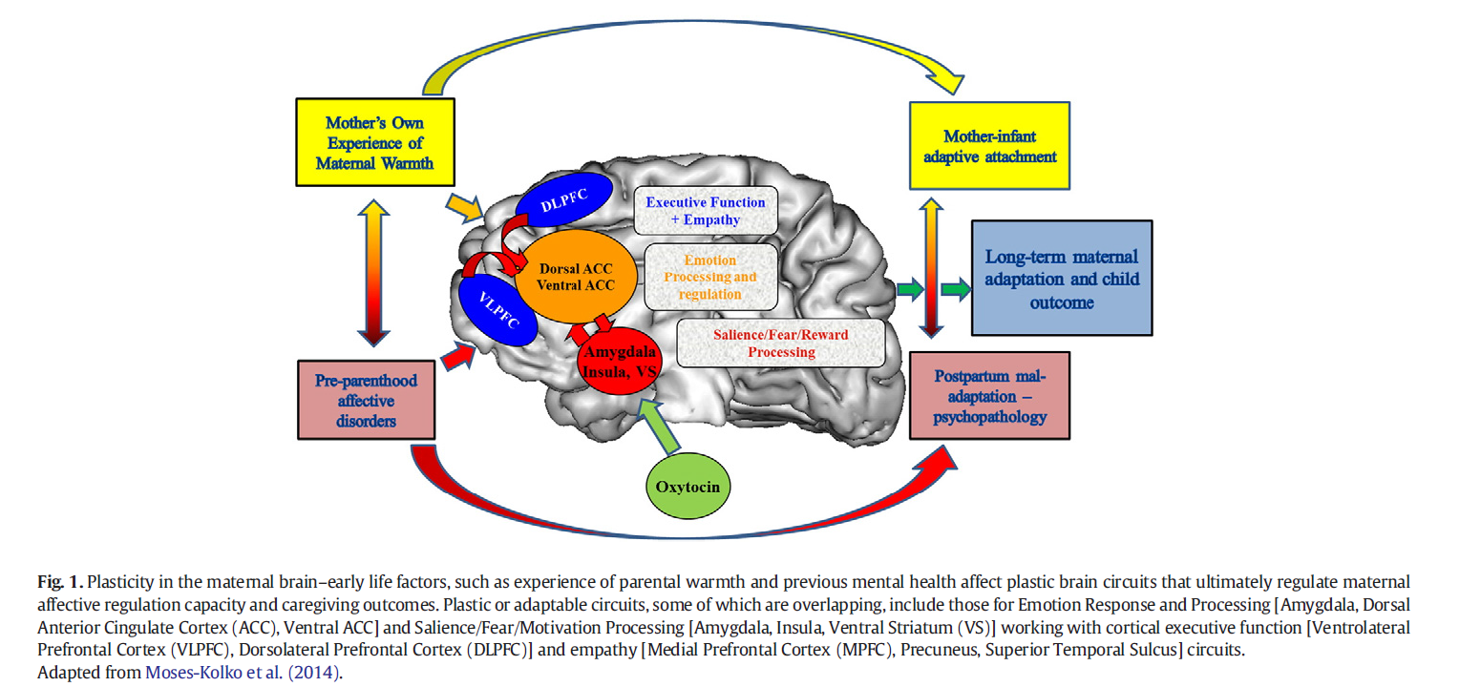
PARENTING IS REWARDING, AND OFTEN DIFFICULT AND STRESSFUL
The brain works in conjunction with other bodily changes, like the release of hormones (e.g., oxytocin; Luo et al., 2015) and activation of stress responsive systems, in order to support parenting behavior.

Slide 44
PARENTING IS REWARDING, AND OFTEN DIFFICULT AND STRESSFUL
The brain works in conjunction with other bodily changes, like the release of hormones (e.g., oxytocin; Luo et al., 2015) and activation of stress responsive systems, in order to support parenting behavior.
Many parts of the human brain that respond to stressful situations are also involved in directing parenting behavior.

Slide 45
PARENTING IS REWARDING, AND OFTEN DIFFICULT AND STRESSFUL
The brain works in conjunction with other bodily changes, like the release of hormones (e.g., oxytocin; Luo et al., 2015) and activation of stress responsive systems, in order to support parenting behavior.
Many parts of the human brain that respond to stressful situations are also involved in directing parenting behavior.
Parents who face many stressors outside of the parenting domain may face an additional burden in mobilizing these systems for caregiving as well as for survival

Slide 46
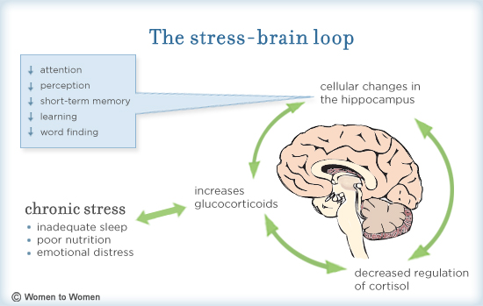
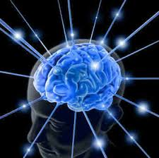
Trauma, Stress, Depression

Slide 47
PARENTS’ OWN EXPERIENCES CAN SHAPE HOW THEY INTERACT WITH THEIR INFANT
Brain areas that process infant cries can activate more strongly to distressed infant cues and less strongly to positive infant cues in mothers experiencing stress (P. Kim et al., 2017; Swain & Ho, 2017)
What does it look like when brain changes have not occurred to support caregiving?

Slide 48
PARENTS’ OWN EXPERIENCES CAN SHAPE HOW THEY INTERACT WITH THEIR INFANT
Hearing an infant cry may be more aversive or arresting for those mothers who experienced adversity and thus may make it more difficult to respond sensitively to an infant’s needs

Slide 49
PARENTS’ OWN EXPERIENCES CAN SHAPE HOW THEY INTERACT WITH THEIR INFANT
Hearing an infant cry may be more aversive or arresting for those mothers who experienced adversity and thus may make it more difficult to respond sensitively to an infant’s needs
Alternatively, they may not feel as rewarded when interacting with their infant if their brain does not respond as strongly to positive infant cues (Kim et al., 2016)

Slide 50
Adaptive, at a cost
Although overemphasizing distress may aid infant and parent survival in adverse circumstances, that may come at the cost of sensitive interactions in responding to non-distress signals

Slide 51
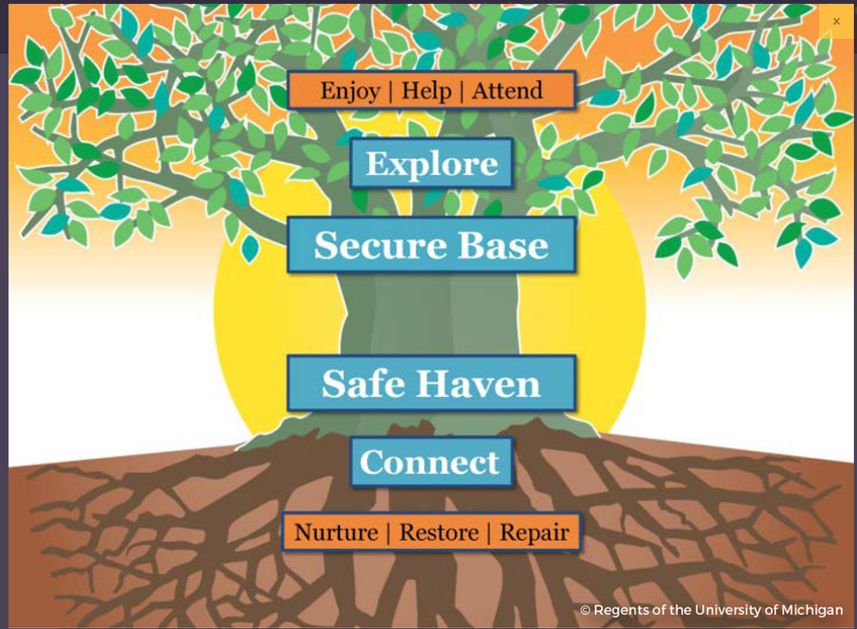
Mom Power
https://www.tamho.org/uploads/pdfs/2017%20IMH%20Conference/Morelen/Mom%20Power%20__One%20Pager__.pdf

Slide 52
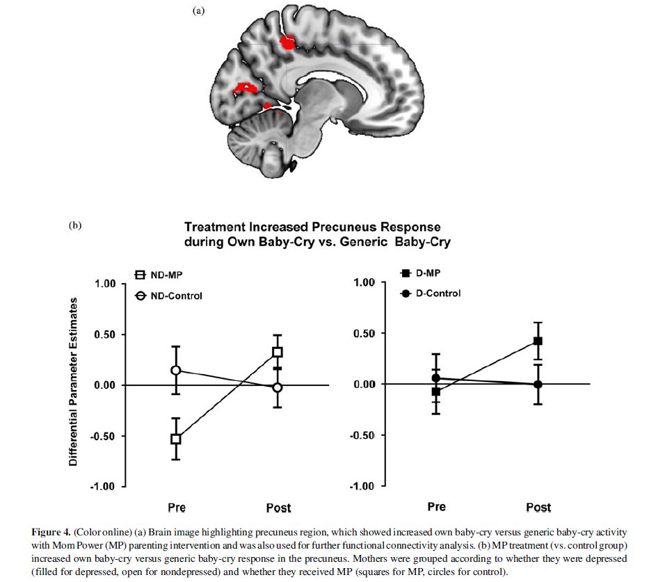
Targeted Parent-Child Intervention? Pilot Study of ‘Mom Power’
Swain, J. E., Ho, S. S., Rosenblum, K. L., Morelen, D., Dayton, C. J., & Muzik, M. (2017). Parent–child intervention decreases stress and increases maternal brain activity and connectivity during own baby-cry: An exploratory study. Development and Psychopathology, 29(2), 535-553.

Slide 53
We Can Effect Change
Sensitive Periods are just that
Motivation toward a new infant can be a powerful turning point
Interventions that change relationships can change brain development
We can, have and do implement policies and actions that
change the context and matter for individuals, families and all of us

