Slide 1


MAINE 2GEN SUMMIT: EXPLORE, INSPIRE, INNOVATE
OCTOBER 23, 2023
Marjorie sims
Managing director

Slide 2




About ascend at the aspen Institute
We Are a catalyst and a Convener for diverse leaders working to build Intergenerational family prosperity and well-being
We co-create and elevate innovative two-generation (2Gen) approaches with families and partners to forge pathways to family prosperity and intergenerational well-being for both children and the adults in their lives.
We invest in leadership to advance systems, policy, and narrative change.
We elevate and scale ideas and innovations that show early traction in communities.
We leverage the power of convening and foster radical collaboration.

Slide 3













Theory of policy & systems change
drive change through combining the parent recommendations, research, and promising practices
Policy & systems change for children & families
Policies for children & families
Family voice & expertise
Data, research & evidence
Best & promising practice

Slide 4


2gen
The approach and movement for building intergenerational
family prosperity and well-being

Slide 5







The origins & evolution of 2gen in the us
∞
The intuitive link between individual and collective success has long been recognized by indigenous communities in the U.S. and around the globe.
1965
As part of ‘The War on Poverty,’ President LBJ launched Head Start to provide comprehensive early childhood education and parent involvement services to families.
2012
Ascend published the “Two Generations, One Future” report, laying the groundwork for the launch of the Ascend Network to foster development of the 2Gen field. 2Gen 2.0
Late 1800s
The Settlement House movement supported the entire family of those immigrating to the US.
1988
The term ’Two-Generation’ was coined by the Foundation for Child Development to reflect programs that were emerging across the country. 2Gen 1.0
2021
Ascend released the “State of the
Field: Two-Generation
Approaches to Family Well-Being” report outlining a vision for vision for expansion and implementation

Slide 6





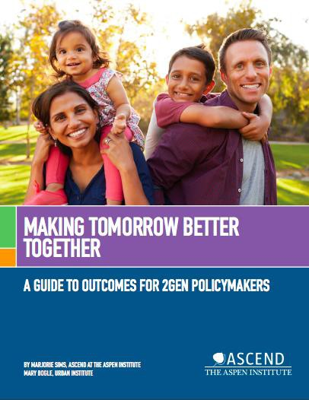
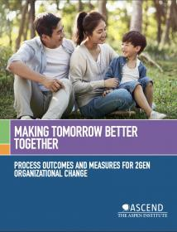

Outcomes & learnings from 2gen 1.0
Intentional service integration is critical
Quality matters
Intensity is important
Who is targeted matters
How you work with families matters

Slide 7
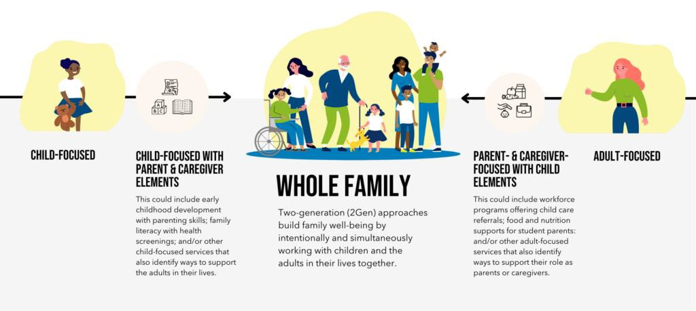
2Gen builds family well-being by intentionally and simultaneously working with children and the adults in their lives together.
About the two-generation (2gen) approach

Slide 8





5 guiding principles for 2gen approaches
Measure and account for outcomes for
both children and the adults in their lives.
Engage voices and recommendations of families.
Ensure equity, particularly racial equity.
Foster innovation and evidence together.
Align and link systems and funding streams.

Slide 9
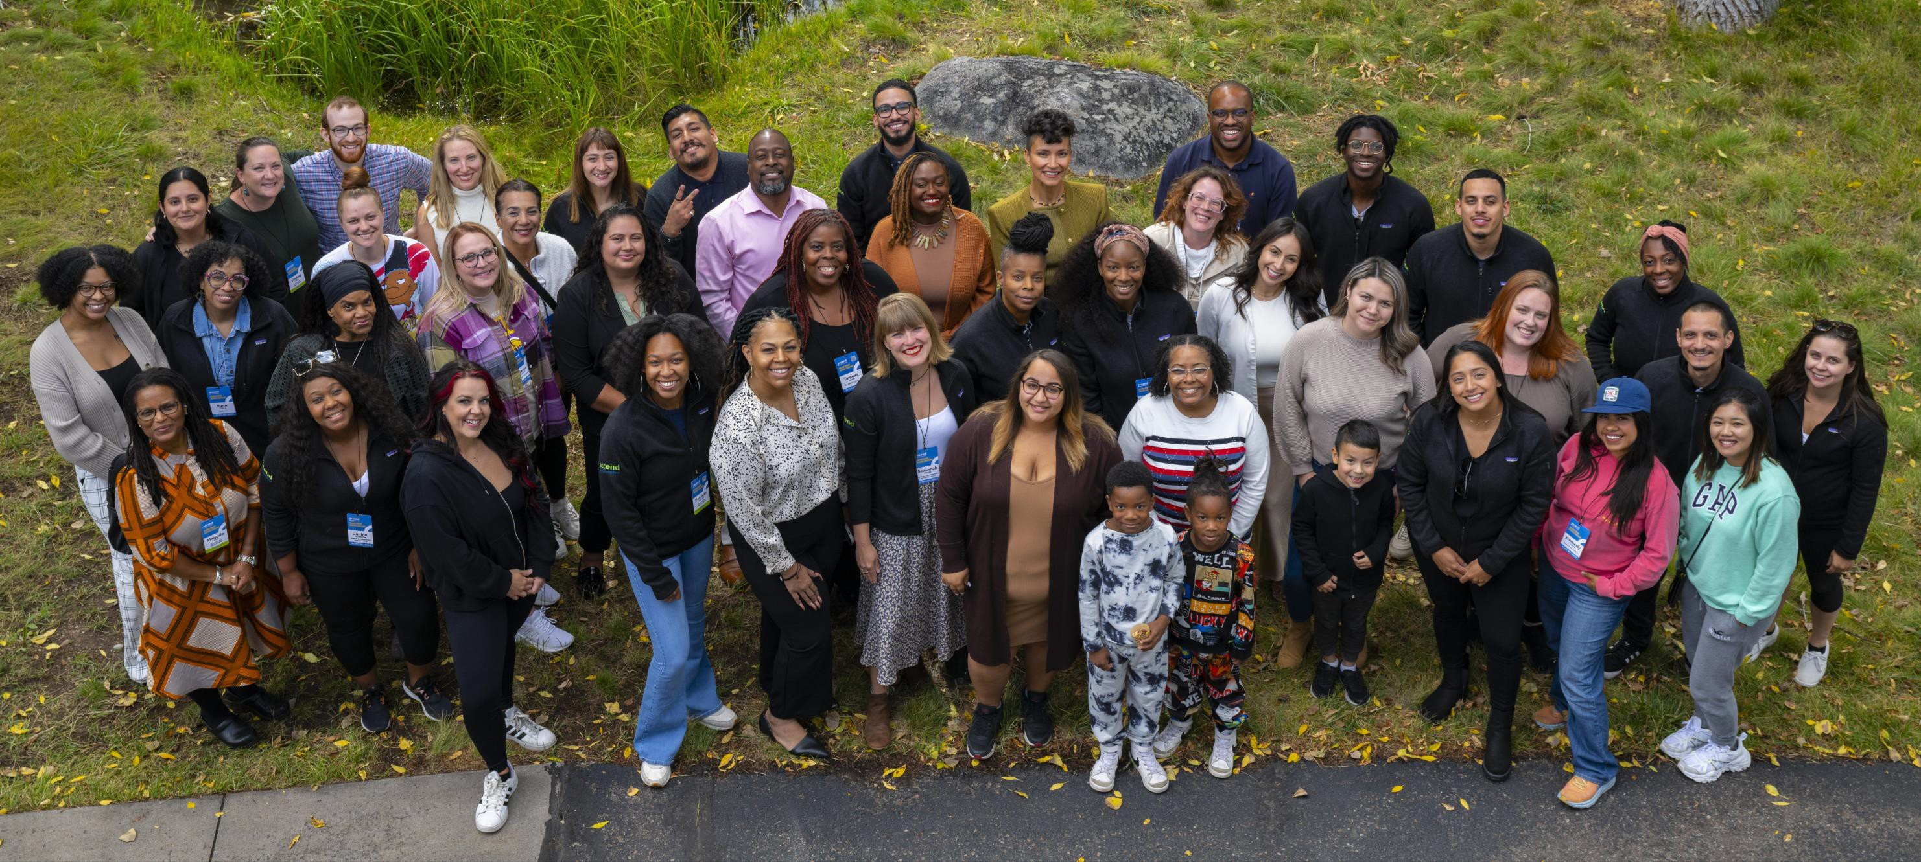
Ascend Parent advisors Convening

Slide 10
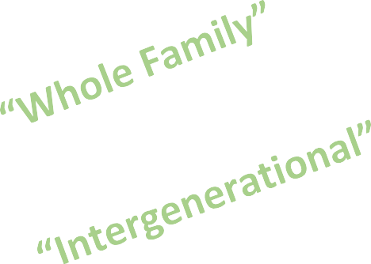


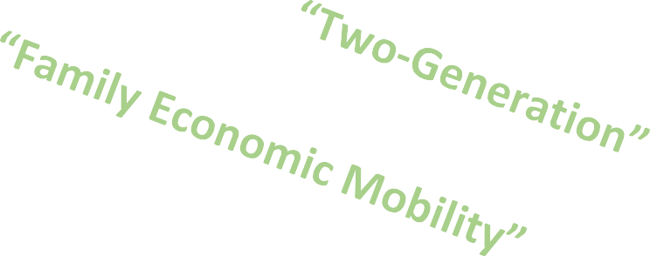


Many names – one approach
2Gen approaches reflect and embrace the diverse shapes, sizes, and structures of families to ensure all family members can reach their full potential.
10

Slide 11
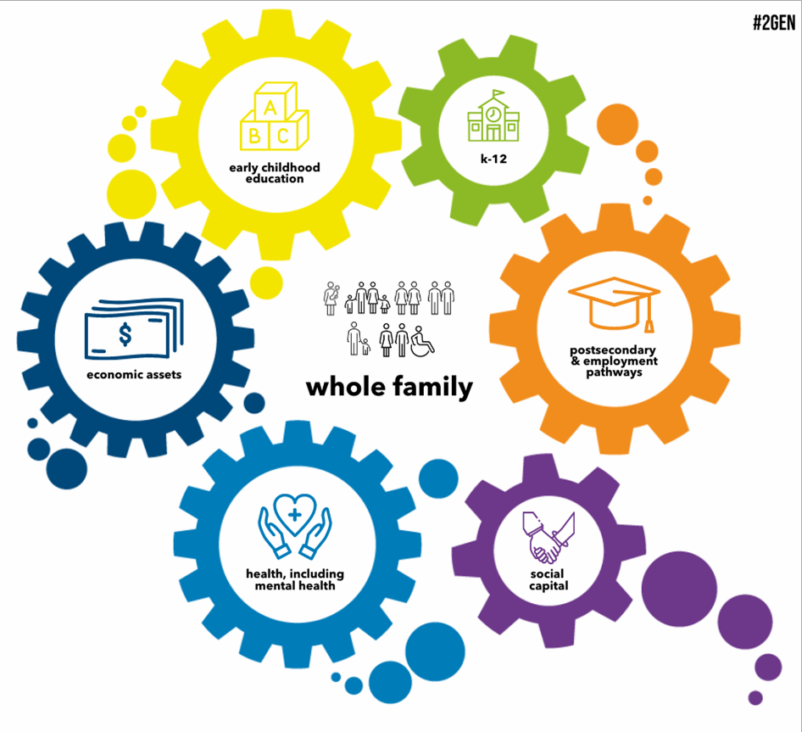
6 Components For
family well-being
Well-being is a multifaceted process and lifelong pursuit.

Slide 12




Research proves 2gen has an outsize impact
Research demonstrates a 13% ROI in high quality early
childhood education. (Heckman, 2016)
A $3,000 increase during early childhood yields a 17% increase in adult earnings. (Duncan & Magnuson, 2011)
The brains of new parents undergo major changes. (Phu, Erhart, Kim, & Watamura, 2020)
Parents with health insurance are more likely to seek care for their children. (Rosenbaum & Whittington, 2007)
Predictable, monthly unconditional cash aid given to low-income families may increase infant brain activity. (Troller-Renfree et al. 2022)
A college degree doubles a parent’s income. (Kominski,
2011)

Slide 13
2gen approach continuum
Parent voice and a focus on Cultural competency is a prerequisite for 2Gen
mindset strategy
organization
A new way of thinking for designing programs and policies that serve children and parents simultaneously.
Aligning and/or coordinating services with other organizations to meet the needs of all family members.
Providing services and supports to both children and adults simultaneously and tracking outcomes for both.

Slide 14
2gen community continuum
7. 2Gen
Accountability
6. 2Gen
Integration
5. 2Gen
Community
Sustained programs & policies
4. 2Gen Strategy
Both children and adults are being simultaneously served in multiple programs across multiple sectors.
3. 2Gen
Approach
Cross-sector stakeholders working collaboratively to provide services to both children and adults simultaneously.
2. 2Gen Aware
Cross-sector stakeholders working collaboratively to align and/or coordinate programs, policies,
organizations and systems to reflect the 2Gen framework and ingrain it in their mission.
1. 2Gen Unaware
Stakeholders aware of and support existing 2Gen organizations, and
move on to “development” if there are any gaps.
Stakeholders beginning to learn about 2Gen and engaging others to learn more.
Fragmented programs and systems due to limited
understanding of the 2Gen framework.

Slide 15

Ascend network
The community of over 500 organizations driving 2Gen in policies and practices at local, state, and federal levels.

Slide 16

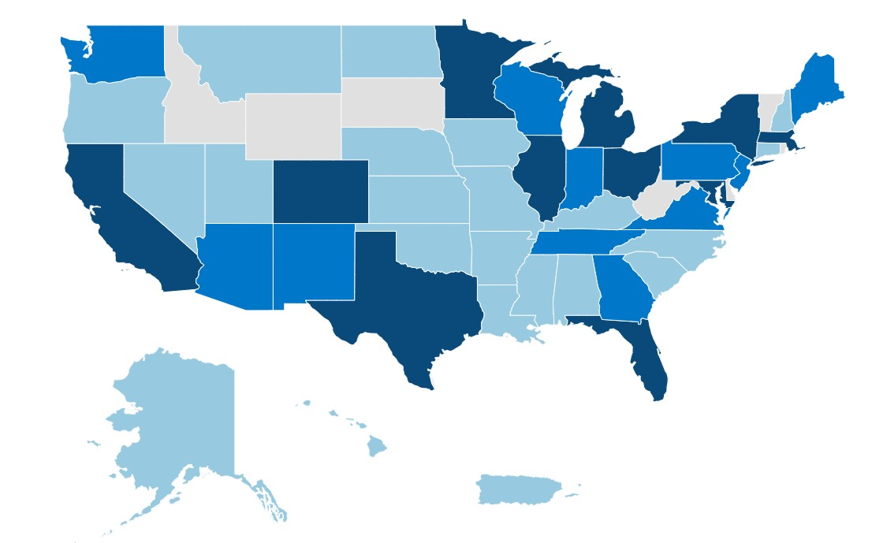

2gen leaders across the country
12M+
$34B
in public resource funding that Fellows steward to transform how key sectors support communities across the US.
Children and families are reached by Ascend leaders.
541
Network Partners organization implementing 2Gen.
140
Ascend Fellows are leading levers of change, innovation, and impact across key sectors that influence family well-being.
50 states +
We’re in all 50 states, DC, and
Puerto Rico.
4 countries
We’ve also gone global and now reach
Guatemala, Ireland, and Rwanda.

Slide 17
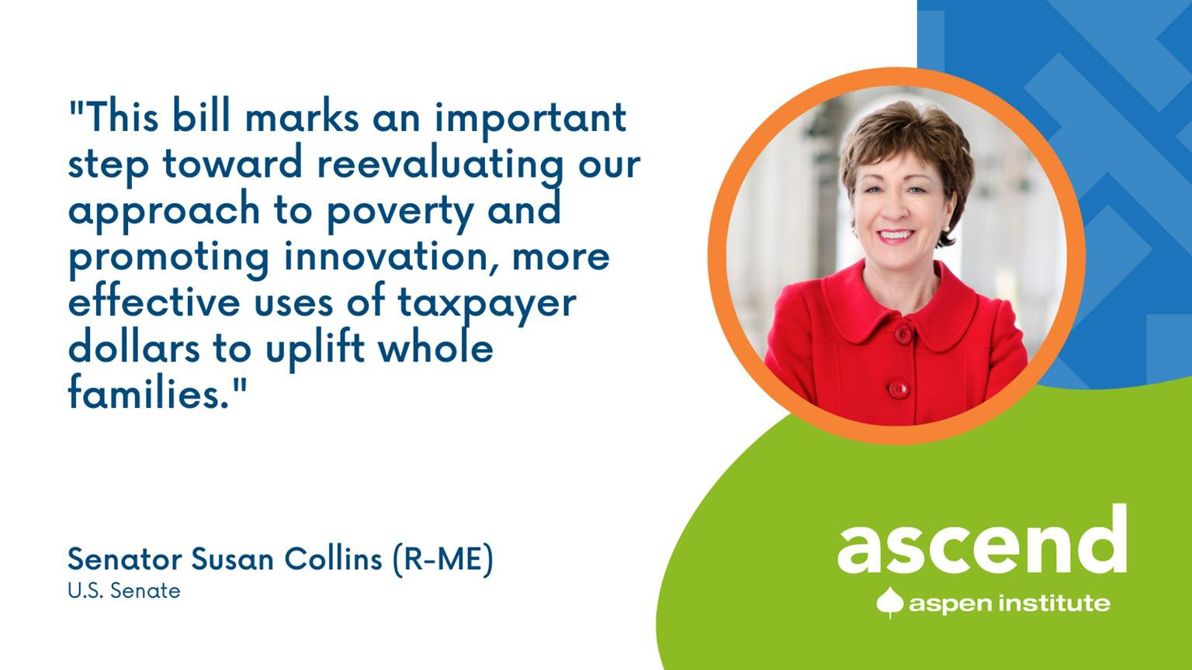
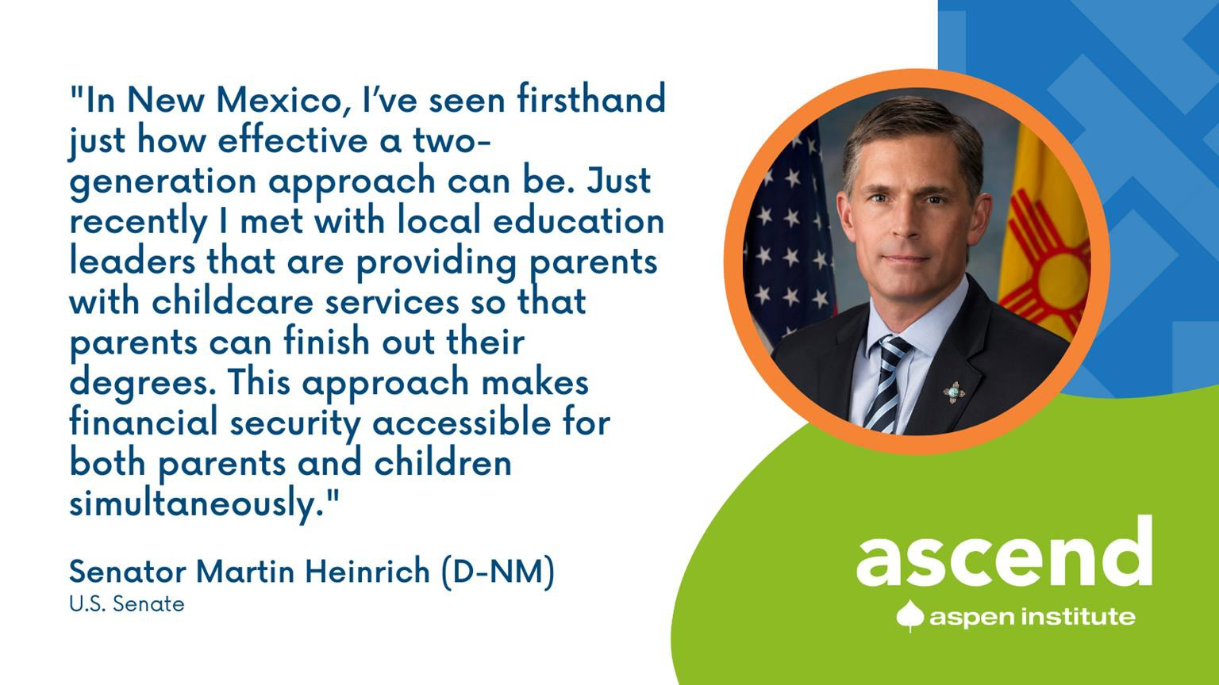
2gen movement in congress
2Gen Economic Empowerment Act or the “2Gen Bill” (Senators
Heinrich and Collins)
  Introduced for four consecutive Congresses
Health Profession Opportunity Grants
Government Accountability Office (GAO)
  2020 Report: HHS Can Improve Information to Assist States and Localities in Adopting Approaches That Serve Whole Families

Slide 18
“Don’t just meet us where we are.
Meet us where we dream.”
Janine mcmahon
Ascend Parent Advisor

